Slide 1

Big Data Storage and Processing MSc in Data Analytics CCT College Dublin
Apache Pig
Week 8
Lecturer: Dr. Muhammad Iqbal*
Email: miqbal@cct.ie
©CCT College Dublin 2022

Slide 2
Agenda
Introduction to Apache Pig
Apache Pig: Terminology and Operations
Apache Pig: MapReduce and Execution Modes
Apache Pig: Logical and Physical Plan
Apache Pig: Simple & Complex Data Types and Input And Output
Apache Pig: Relational Operators
Apache Pig: User Defined Functions

Slide 3

Introduction to Apache Pig
Yahoo created Apache Pig to simplify the process of mining Big datasets.
Apache Pig provides a higher level of abstraction for processing Big datasets.
It can be challenging to figure out how to fit your data processing into this pattern, which involves numerous MapReduce stages, despite the fact that MapReduce allows you to provide a map function followed by a reduce function.
Apache Pig has much richer data structures, most of which are multivalued and nested and more powerful transformations. They include joins, for example, which are not considered as attractive in MapReduce. Pig is made up of two pieces
The language used to express data flows, called Pig Latin.
The execution environment to run Pig Latin programs. There are currently two environments: local execution in a single JVM and distributed execution on a Hadoop cluster.

Slide 4
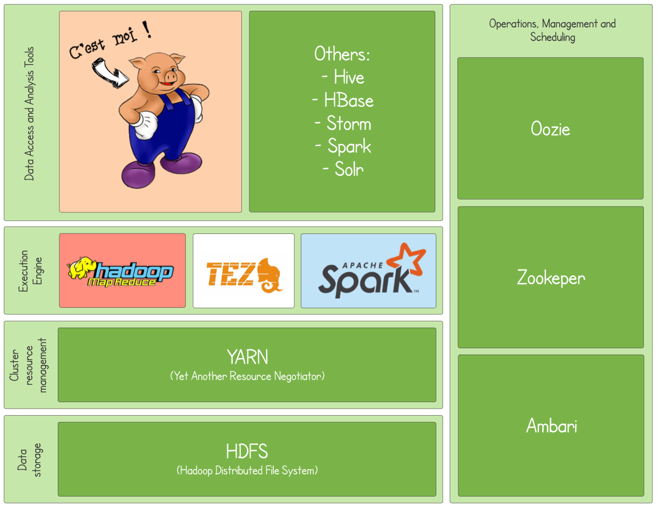
Introduction to Apache Pig
Pig Latin programs consist of multiple operations, or transformations, applied to input data to produce output.
The operations describe a data flow that is translated into an executable representation and then executed by the Pig execution environment.
Pig transforms the data into a series of MapReduce jobs, but as a programmer you are mostly unaware of this, so you are able to concentrate on the data instead of the execution.
Pig is a scripting language for exploring Big datasets. One criticism of MapReduce is that the development cycle is very long.

Slide 5
Introduction to Apache Pig
A mapper and reducer need to be written, compiled and packaged, submitted, and the results retrieved can be a lengthy process, and even with Streaming, which removes compiling and packaging, the experience would still be required.
A significant characteristic of Pig is its ability to process terabytes of data in response to a half-dozen lines of Pig Latin.
It is easy for a programmer to write a query in Pig, since it provides a number of commands that allow you to infer the data structures in your program.
It enables easy data summarization, ad-hoc reporting and querying, and analysis of Big volumes of data.
Pig interpreter runs on a client machine and there are not any administrative overhead required.

Slide 6
Apache Pig Terminology
Four major kinds of data is stored in Pig as mentioned below
An Atom is a simple data value - stored as a string but can be used as either a string or a number.
A Tuple is a data record consisting of a sequence of "fields“.
Each field is a piece of data of any type (atom, tuple or bag)
A Bag is a set of tuples (also referred to as a ‘Relation’).
The concept of a “kind of a” table.
A Map is a map from keys that are string literals to values that can be any data type.
The concept of a hash map.

Slide 7
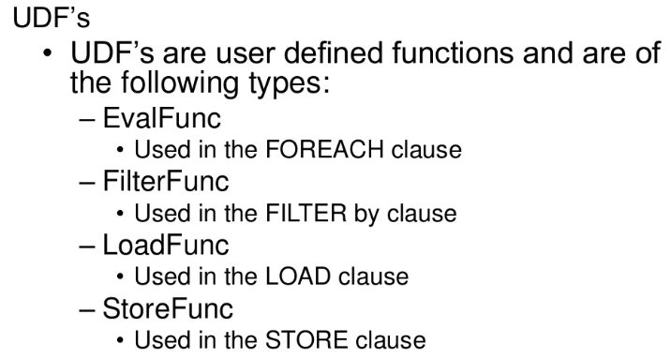
Apache Pig Operations
Apache Pig provides the following operations
Grouping and Joining
Combining and Splitting
Filtering
Aggregation
Sorting
Extensibility
Support for User Defined Functions (UDF’s)
Takes advantage of the same massive parallelism as native MapReduce

Slide 8
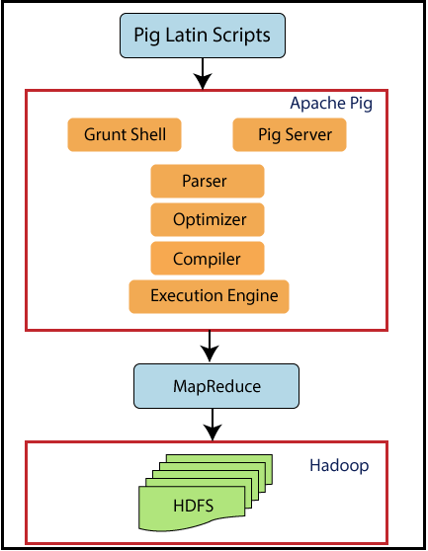
Apache Pig MapReduce
Pig is a client application
Requirement of a cluster is not essential
Interprets Pig Latin scripts to MapReduce jobs
Parses Pig Latin scripts
Performs optimization
Performs compilation
Creates execution plan
Submits MapReduce jobs to the hdfs cluster
Notes:
To parse, in computer science, is where a string of commands – usually a program – is separated into more easily processed components, which are analyzed for correct syntax and then attached to tags that define each component. The computer can then process each program chunk and transform it into machine language.

Slide 9
Apache Pig Execution Modes
Pig has two execution modes
Local Mode - all files are installed and run using your local host and file system
MapReduce Mode - all files are installed and run on a Hadoop cluster and HDFS installation
Interactive
By using the Grunt shell by invoking Pig on the command line
$ pig -x local
grunt>
Batch
Run Pig in batch mode using Pig Scripts and the "pig" command
$ pig –f id.pig –p <param>=<value> ...

Slide 10
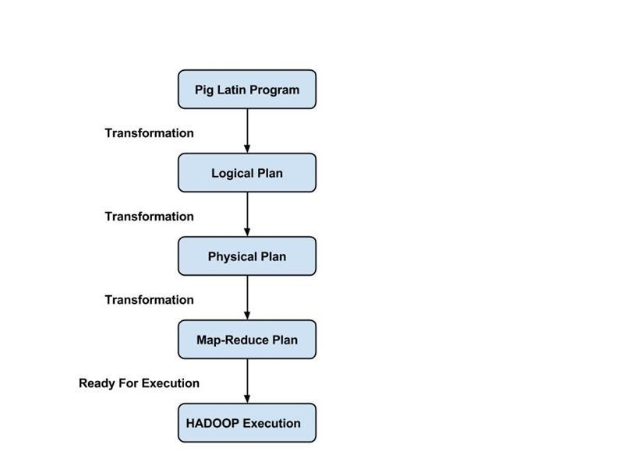
Apache Pig Logical and Physical Plan
Pig Latin scripts are generally organized as follows
A LOAD statement reads data
A series of “transformation” statements process the data
A STORE statement writes the output to the filesystem
A DUMP statement displays output on the screen
Logical vs. physical plans
All statements are stored and validated as a logical plan
Once a STORE or DUMP statement is found, the logical plan that will executed

Slide 11
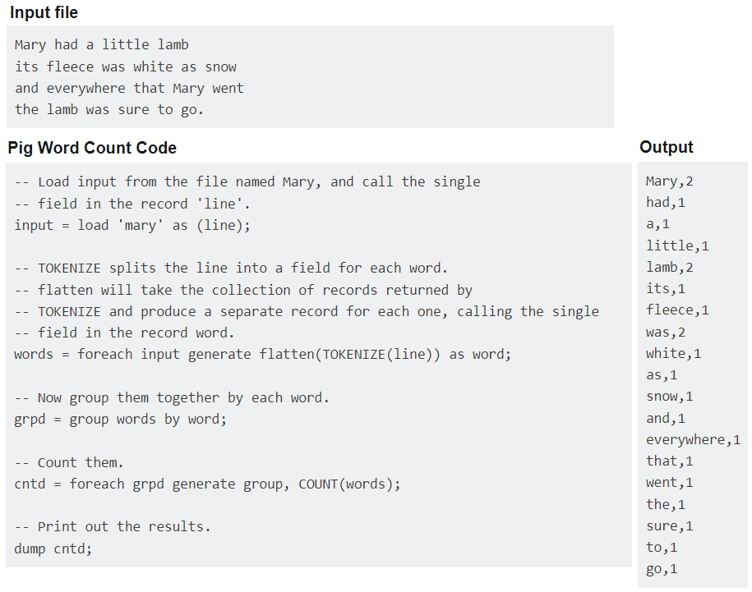
Apache Pig Sample Script

Slide 12
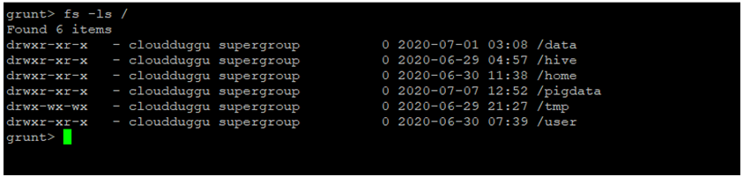
Apache Pig “grunt” Shell
Help is available
$ pig -h
Pig supports HDFS commands
grunt> pwd
put, get, cp, ls, mkdir, rm, mv, etc.
Pig Latin statements grouped together in a file
Can be run from the command line or the shell
Support parameter passing
Comments are supported
Inline comments '--'
Block comments /* */

Slide 13
Apache Pig Simple & Complex Data Types
Type | Description
int | 4-byte integer
long | 8-byte integer
float | 4-byte (single precision) floating point
double | 8-byte (double precision) floating point
bytearray | Array of bytes; blob
chararray | String (“hello world”)
boolean | True/ False (case insensitive)
datetime | A date and time
biginteger | Java BigInteger
bigdecimal | Java BigDecimal
Complex Data Types
Type | Description
Tuple | Ordered set of fields (a “row / record”)
Bag | Collection of tuples (a “resultset / table”)
Map | A set of key-value pairs Keys must be of type chararray

Slide 14
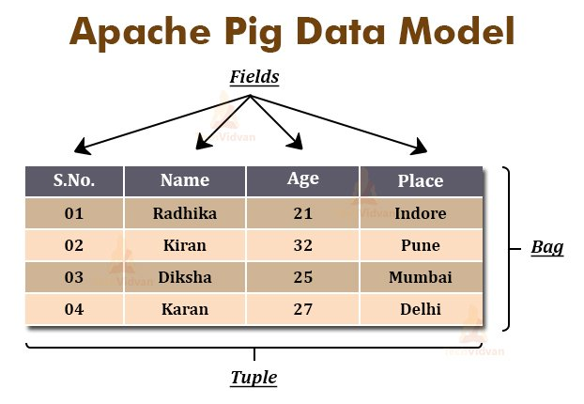
Apache Pig Data Formats
BinStorage
Loads and stores data in machine-readable (binary) format
PigStorage
Loads and stores data as structured, field delimited text files
TextLoader
Loads unstructured data in UTF-8 format
PigDump
Stores data in UTF-8 format
YourOwnFormat!
via UDFs
Notes:
UTF-8 is a variable-width character encoding used for electronic communication. Defined by the Unicode Standard, the name is derived from Unicode Transformation Format – 8-bit. UTF-8 is capable of encoding all 1,112,064 valid character code points in Unicode using one to four one-byte code units.

Slide 15
Apache Pig Data Loading Example
Loads data from an HDFS file
var = LOAD 'employees.txt';
var = LOAD 'employees.txt' AS (id, name, salary);
var = LOAD 'employees.txt' using PigStorage()
AS (id, name, salary);
Each LOAD statement defines a new bag
Each bag can have multiple elements (atoms)
Each element can be referenced by the name or position ($n)
A bag is immutable
A bag can be aliased and referenced later
Notes:
Immutable data is a piece of information in a database that cannot be (or shouldn't be) deleted or modified. Most traditional databases store data in a mutable format, meaning the database overwrites the older data when new data is available.

Slide 16
Apache Pig Input And Output
STORE
Writes output to an HDFS file in a specified directory
grunt> STORE processed INTO 'processed_txt';
Fails if directory exists
Writes output files, part-[m|r]-xxxxx, to the directory
PigStorage can be used to specify a field delimiter
DUMP
Write output to screen
grunt> DUMP processed;

Slide 17
Apache Pig Relational Operators
FOREACH
Applies expressions to every record in a bag
FILTER
Filters by expression
GROUP
Collect records with the same key
ORDER BY
Sorting
DISTINCT
Removes duplicates

Slide 18
Apache Pig FOREACH . . .GENERATE
Use the FOREACH …GENERATE operator to work with rows of data, call functions, etc.
Basic syntax:
alias2 = FOREACH alias1 GENERATE expression;
Example:
DUMP alias1;
(1,2,3) (4,2,1) (8,3,4) (4,3,3) (7,2,5) (8,4,3)
alias2 = FOREACH alias1 GENERATE col1, col2;
DUMP alias2;
(1,2) (4,2) (8,3) (4,3) (7,2) (8,4)

Slide 19
Apache Pig FILTER. . .BY
Use the FILTER operator to restrict tuples or rows of data
Basic syntax:
alias2 = FILTER alias1 BY expression;
Example:
DUMP alias1;
(1,2,3) (4,2,1) (8,3,4) (4,3,3) (7,2,5) (8,4,3)
alias2 = FILTER alias1 BY (col1 == 8) OR (NOT (col2+col3 > col1));
DUMP alias2;
(4,2,1) (8,3,4) (7,2,5) (8,4,3)

Slide 20
Apache Pig GROUP. . .ALL
Use the GROUP…ALL operator to group data
Use GROUP when only one relation is involved
Use COGROUP with multiple relations are involved
Basic syntax:
alias2 = GROUP alias1 ALL;
Example:
DUMP alias1;
(John,18,4.0F) (Mary,19,3.8F) (Bill,20,3.9F) (Joe,18,3.8F)
alias2 = GROUP alias1 BY col2;
DUMP alias2;
(18,{(John,18,4.0F),(Joe,18,3.8F)})
(19,{(Mary,19,3.8F)})
(20,{(Bill,20,3.9F)})

Slide 21
Apache Pig ORDER. . .BY
Use the ORDER…BY operator to sort a relation based on one or more fields
Basic syntax:
alias = ORDER alias BY field_alias [ASC|DESC];
Example:
DUMP alias1;
(1,2,3) (4,2,1) (8,3,4) (4,3,3) (7,2,5) (8,4,3)
alias2 = ORDER alias1 BY col3 DESC;
DUMP alias2;
(7,2,5) (8,3,4) (1,2,3) (4,3,3) (8,4,3) (4,2,1)

Slide 22
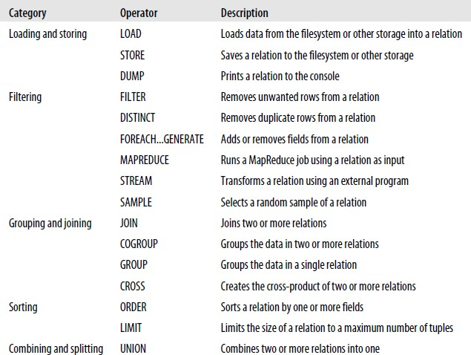
Apache Pig Relational Operators
FLATTEN
Used to un-nest tuples as well as bags
INNER JOIN
Used to perform an inner join of two or more relations based on common field values
OUTER JOIN
Used to perform left, right or full outer joins
SPLIT
Used to partition the contents of a relation into two or more relations
SAMPLE
Used to select a random data sample with the stated sample size
https://www.w3schools.com/sql/sql_join_inner.asp

Slide 23
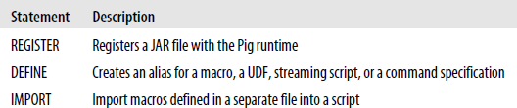
Apache Pig User-Defined Functions
UDF are written in Java, packaged as a jar file
Other languages include Jython, JavaScript, Ruby, Groovy, and Python
Register the jar with the REGISTER statement
Optionally, alias it with the DEFINE statement
REGISTER /src/myfunc.jar;
A = LOAD 'students';
B = FOREACH A GENERATE
myfunc.MyEvalFunc($0);
Pig Latin Macro and UDF Statements
Enable to incorporate macros and user-defined functions into Pig scripts
Macro is a kind of function written in Pig Latin.
Notes:
Jython is an open source implementation of the Python programming language, integrated with the Java platform. A programmer can compile Python source code to Java bytecode , and run the code on any Java virtual machine . The integration of Python and Java gives programmers access to all Java libraries.
Groovy is a dynamic object-oriented programming language for the Java virtual machine (JVM) that can be used anywhere Java is used. The language can be used to combine Java modules, extend existing Java applications and write new applications.

Slide 24
Resources/ References
https://pig.apache.org
White,T., 2012. Hadoop:The definitive guide. "O'Reilly Media, Inc.". Thottuvaikkatumana, R., 2016.
Some slides are used from the Boston University resources for learning purpose as mentioned as https://www.cs.bu.edu/faculty/gkollios/ada17/LectNotes/PigHive.pptx
https://www.javatpoint.com/pig-udf
https://www.cloudduggu.com/pig/
Some images are used from Google search repository (https://www.google.ie/search) to enhance the level of learning.
Copyright Notice The following material has been communicated to you by or on behalf of CCT College Dublin in accordance with the Copyright and Related Rights Act 2000 (the Act). The material may be subject to copyright under the Act and any further reproduction, communication or distribution of this material must be in accordance with the Act. Do not remove this notice

